Slide 1

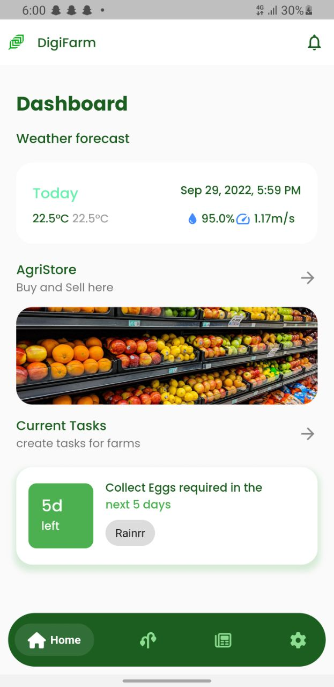
DIGITAL AGRICULTURE
College of Science
DEPARTMENT OF COMPUTER SCIENCE
SUPERVISED BY: DR. LYNDA AMOAKO BANNING
INTRODUCTION
PROBLEM STATEMENT
ACHIEVEMENTS
APPLICATION TESTING
Traditional farming methods for managing farms have proven less effective and less productive in solving food shortages and other unpredictable disasters resulting from the alarming population growth over the past decade.
Farmers on this part of the world, especially countries like Ghana (where over 50% of the population are farmers) rely mostly on intuition and other centuries old traditional method which have been proven to be less productive to cultivate crops.
Due to factors like relying on rainfall to irrigate farmlands, wasteful heuristics methods to know the type of crops to grow on a particular soil type and farmland.
This contributes to our low number of post-harvests which is estimated around an average of 20-50% every year.
Relative to the increase in the world’s population, productivity in agriculture (farming) also has to increase to mitigate the problems arising from increasing population.
Traditional farming methods for managing farms have proven less effective and less productive in solving food shortages and other unpredictable disasters resulting from the alarming population growth over the past decade.
Farmers can make judgments about their farmland based on the knowledge of the meteorological conditions provided by the application.
A notification system was created, to notify the farmer or user of their scheduled agricultural activities.
Agricultural information has been made available to give farmers a one-stop shop for conducting crop research
Individual modules were tested independently to find and fix faults, they were then integrated and the application was tested with real-world data to determine whether the modules could work together as expected.
These unexpected outcomes could be the consequence of the user formatting the output and accidentally feeding some data into the wrong area. The end-user will then be informed of each of these failures with the proper notifications.
OBJECTIVE
The application was created with the purpose of assisting farmers with farm management tasks, giving them access to crucial data, and connecting them with potential customers in order to help farmers use technology as a multiplier and accelerator in producing crops and resolving avoidable losses in farming.
CONCLUSION
This project introduces the use of weather APIs to give farmers with reliable weather information and a farm management system to aid in the planning of farming activities. With machine learning algorithms, it will support farmers in making decisions. It will function as a central hub for crop research for farmers.
Some of the difficulties encountered in the development of this project are accessibility to data and the high cost of services in the agricultural sector.
With the right funding, this application can be developed to address the needs of both small and large-scale farms.
DEVELOPMENT TOOLS
VS CODE
FLUTTER
GOOGLE FIREBASE
RAPID API
JUPYTER NOTEBOOK
FLASK
METHODOLOGY
This system was developed using the Incremental model. This approach is due to user exposure and evolving it through numerous phases till the whole system is developed. This strategy interweaves project specifications, development, and system validation to provide timely feedback upon delivery.
Also, It is easier to test and debug during a smaller iteration. It is easier to manage risk because risky pieces are identified and handled during iteration
REFERENCES
Varghese, R., & Sharma, S. (2018). Affordable Smart Farming Using IoT and Machine Learning. Second International Conference on Intelligent Computing and Control Systems (ICICCS), 645-650, https://doi.org/10.1109/iccons.2018.8663044
Peters, K., Breitsameter, L. & Gerowitt, B. (2014). Impact of climate change on weeds in agriculture: a review. Agron. Sustain. Dev. 34, 707–721. https://doi.org/10.1007/s13593-014-0245-2
Figure 1. Homepage

